Slide 1
SARSA & Q-Learning
Benny Bornfeld

Slide 2
Background
SARSA and Q-Learning are two versions of model-free algorithms.
Their goal is finding the optimal policy.
Both are based on the Temporal Difference method.
The difference is:
SARSA is on-policy
Q-Learning is off-policy

Slide 3
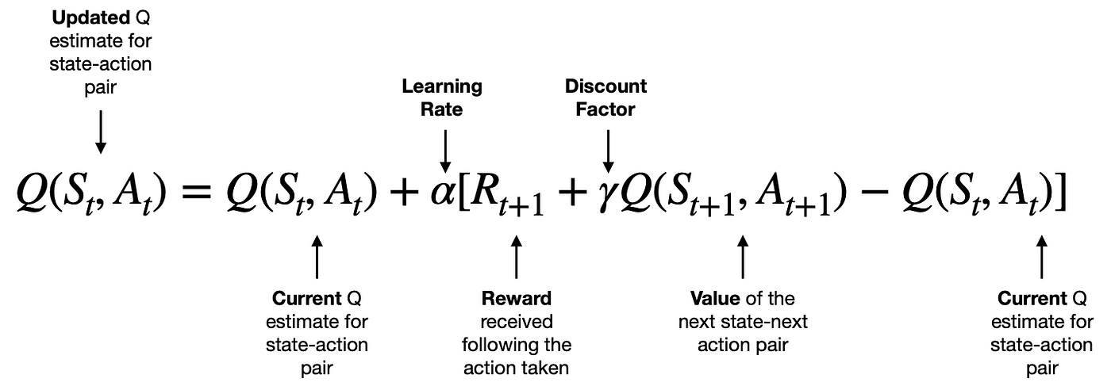
SARSA
SARSA
State
Action
Reward
State (next)
Action (next)
In the optimization process, we will look for the action that will lead us to the maximal value of the next state.
MAX(a)
Since we explore with epsilon-greedy, the action we will take will sometimes be suboptimal. SARSA commits to the next action. We will update the Q value using the value of the state we ended up in. Using Epsilon Greedy, we will choose the action before moving to the next state. This is referred to as on-policy

Slide 4


Example
ϓ = 0.5
We start when all the Q-values are 0
The start cell is S2.
Using epsilon greedy with ϵ= 0.1, the first episode is : S2,S5,S4,S1
The Q-values are updated accordingly
s3
0
s2
0
s1
+1
0
0
0
0
0
0.25
s6
0
s5
s4
0
0
1
0
0
0
0
0
0.5
0
0
0
0
0
0
s9
0
s8
0
s7
0
0
0
0
0
0
0
0
0
0

Slide 5
SARSA
Greedy optimal action:
S2->Down->S5->Right
S2,Down eval = 0 + 0.9 * 0.5
Exploration action
S2->Down->S5->Left
S2,Down eval = 0 + 0.9 * 0
When using SARSA with gamma = 0.1, the value of S2 will be:
92.5%: 0.45
7.5%: 0
s3
0
s2
0
s1
+1
0
0
0
0
0
0.25
s6
0
s5
s4
0
0
1
0
0
0
0
0
0.5
0
0
0
0
0
0
s9
0
s8
0
s7
0
0
0
0
0
0
0
0
0
0

Slide 6
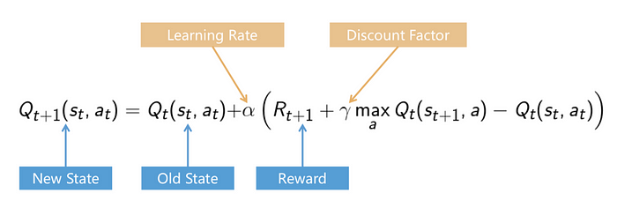
Q-Learning
In Q-Learning, we always update the Q-value using the maximal Q value, regardless of the action that we actually took after the next state. Even if using exploration it choose to take a suboptimal action.

Slide 7

Q-Learning
Greedy optimal action:
S2->Down->S5->Right
S2,Down eval = 0 + 0.9 * 0.5
Exploration action
S2->Down->S5->Left
S2,Down eval = 0 + 0.9 * 0.5
When using Q-Learning with gamma = 0.1, we always get V(s2) = 0.45, although when playing, in 10% of the cases we got 0.
s3
0
s2
0
s1
+1
0
0
0
0
0
0.25
s6
0
s5
s4
0
0
1
0
0
0
0
0
0.5
0
0
0
0
0
0
s9
0
s8
0
s7
0
0
0
0
0
0
0
0
0
0

Slide 8
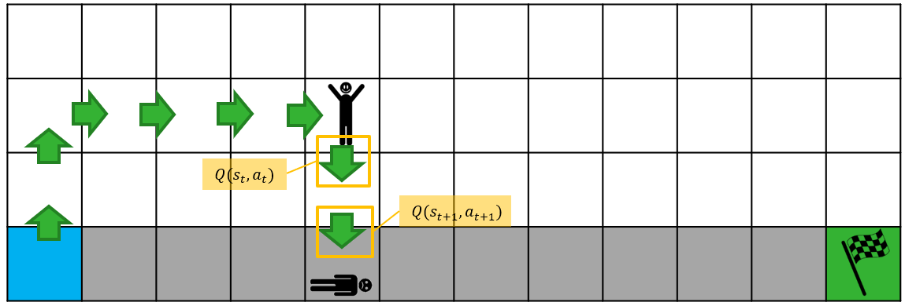
SARSA vs Q-Learning
SARSA is conservative
Q-Learning is optimistic

Slide 9
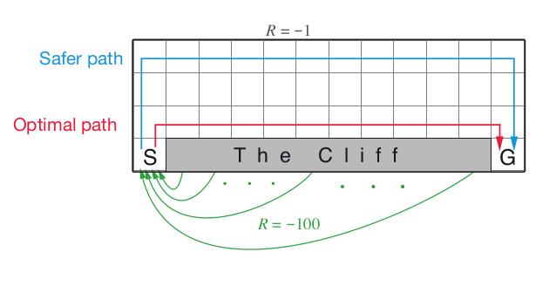
SARSA vs Q-Learning
They will result in different strategies

Slide 10


Slide 11

Q-Learning & SARSA Class ex
The cliff example

